Slide 1
Intros
Ted Kwartler

Slide 2












Ted Kwartler
MBA
Work
Teaching
Advisory Roles

Slide 3
Day 1 – In groups, use Sales Challenge Data & perform EDA and make some slides
08:30 – 10:30
Environment set-up, R, R studio, Git (masterclass only),
Jan AI or LM Studio
(masterclass only)
Some R Coding examples
10:30 – 10:45 Coffee break
10:45 – 12:15 Framing an analytics project
Obtain data, clean/scrub data for modeling
12:15 – 13:15 Lunch time
13:15 – 13:45 Explore data – summary statistics, visualizations
13:45 – 14:30 Sales Challenge Data Group EDA & Visuals Work
14:30 – 15:00 Each group will make a business presentation from their EDA remaining time some groups will be asked to make a presentation to the class
15:00 – 15:15 2 groups will be selected to present their findings
15:15 – 15:30 Coffee break
15:30 – 17:00 Start case data performing Obtain, data cleaning and exploration steps to
create a modeling matrix.
This is the diabetes data

Slide 4
Day 2 - In groups finish either the INN Hotel Cancellations or NewCar scripts and review your model & build a presentation about the findings
08:30 – 10:30
Two three modeling methods, and evaluation [regression, logistic regression, decision trees]
10:30 – 10:45 Coffee break
10:45 – 12:15 Improving model performance examples (ensemble, more observations, more features, feature engineering)
12:15 – 13:15 Lunch time
13:15 – 15:15 Group work to model, evaluate, interpret results then create slides for the INN Hotel Cancellations or New Car Scripts
Masterclass: Create a git repo for your group work
Masterclass: Using JanAI; or LM Studio to extract data from documents for use in modeling & other common uses of LLMs
15:15 – 15:30 Coffee break
15:30 – 17:00 Group presentations including code step through & slides explaining the modeling steps, results and implications

Slide 5

Breaks….I can go and go and go because I like the topics. Please stop me at 90min!
I will try to do 10min breaks at 90min intervals!

Slide 6
Introductions…
Locations?
Professions?
Hopeful Professions/Industries?
Coding Experience?

Slide 7
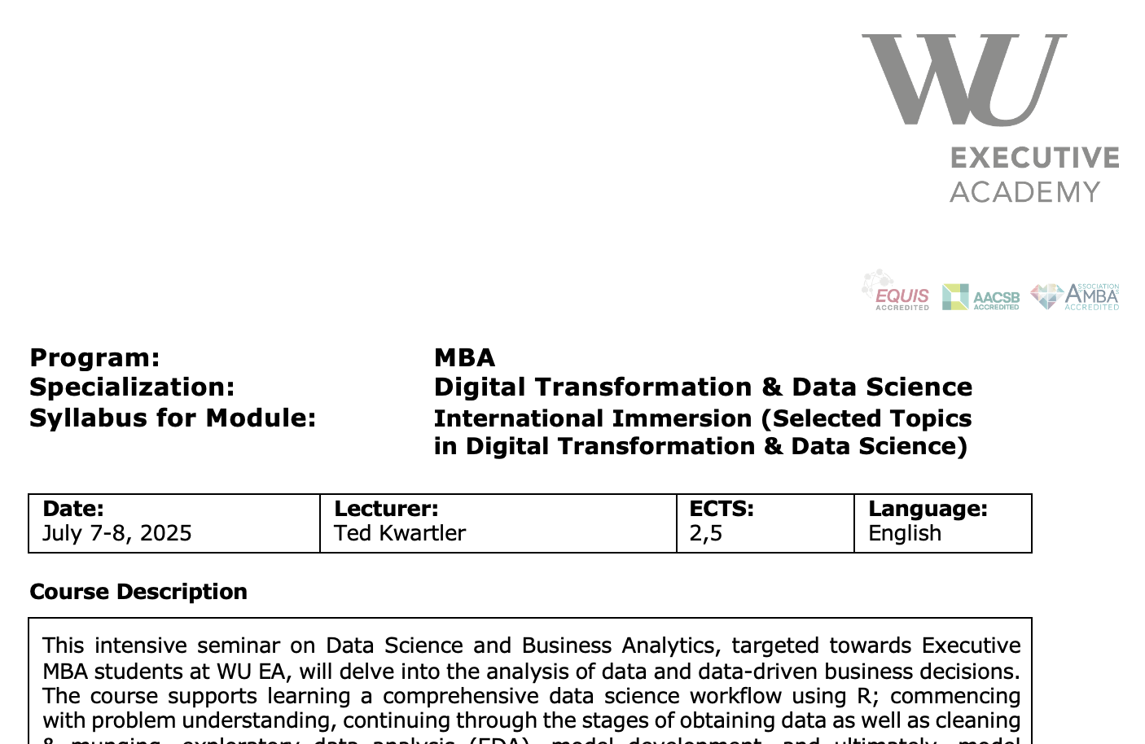
Syllabus Review

Slide 8
Instruction Paradigm
In R
Day 1
Day 2
Obtain
Scrub
Explore
Model
Interpret
Also reviewed in Python
Obtain
Expanded
Scrub
Explore
Model
Interpret
Production
Your curriculum will repeat steps building both upstream and expanding on components using both R and python. In my experience, data science teams prefer R, while production teams python…and most management will let practitioners choose their strongest language. Mechanics are largely similar but good to know regardless of language.

Slide 9
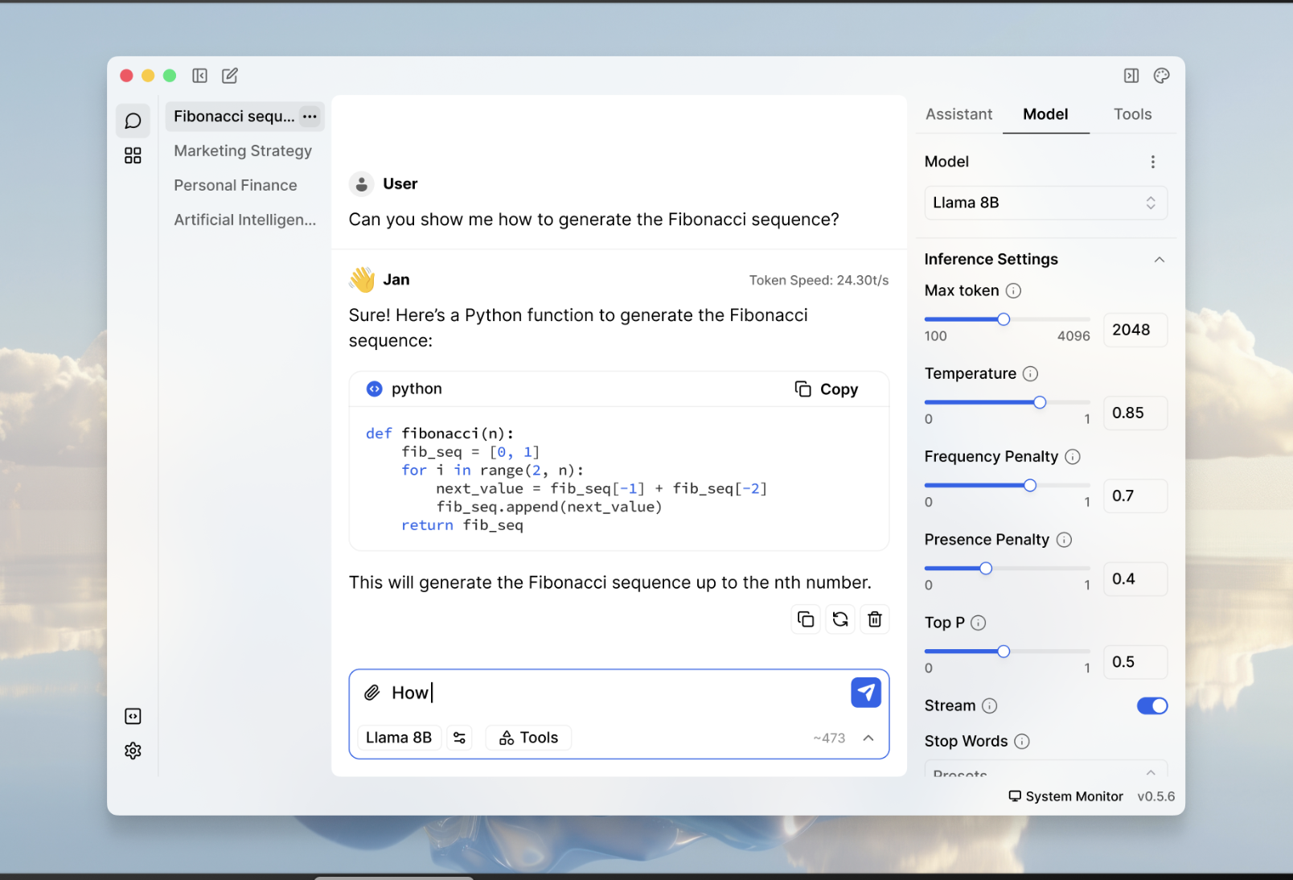
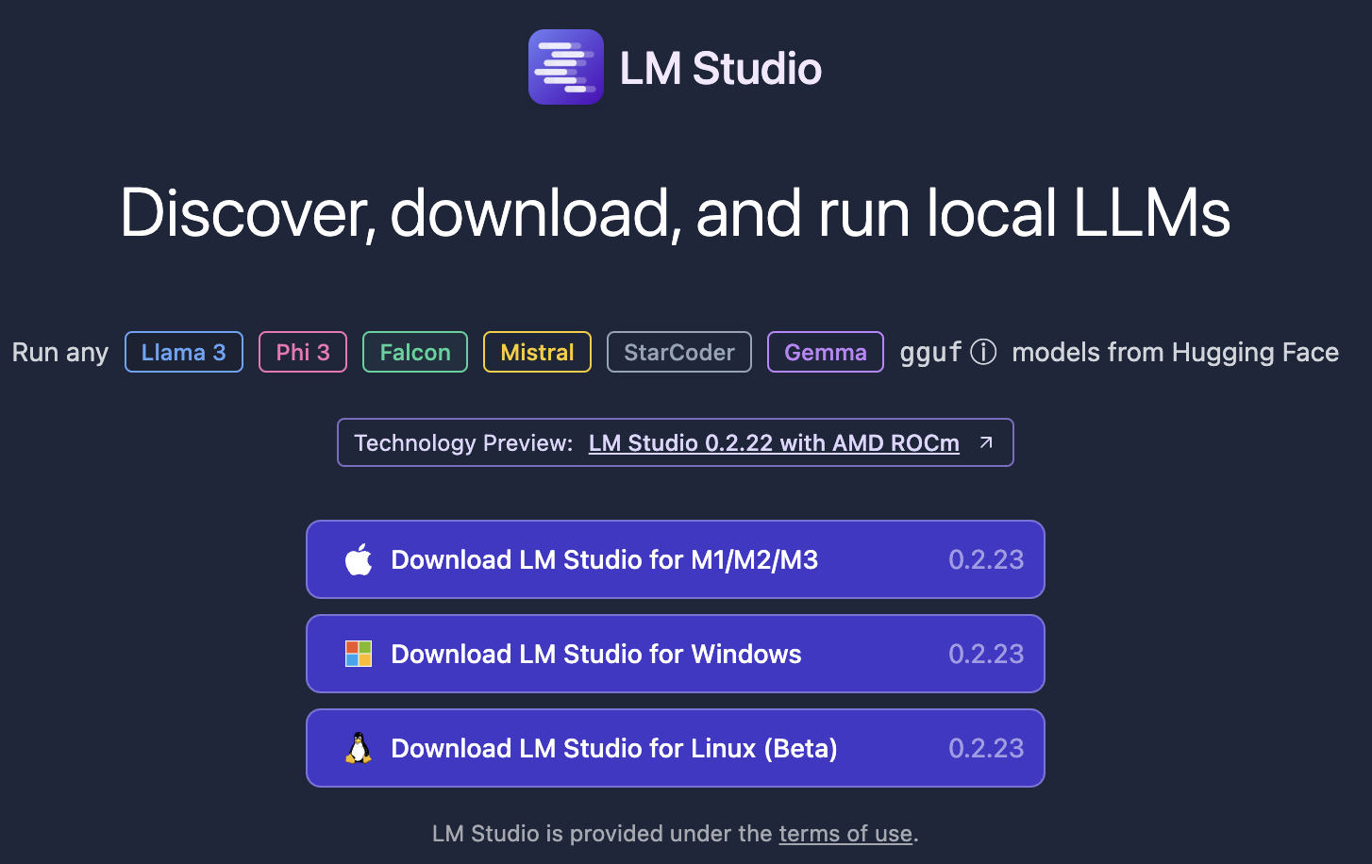
The course uses three four software components for learning.
In the next sections, skip to the method you want to use Local (Mac or Windows, Virtual Machine, Cloud/Hosted)
Integrated Development Environment
Version Control & file sharing
Statistical Software
Run local LLMs
The class will use LM-Studio or Jan.AI, but alternatives could be LM-Studio or if you know about APIs any LLM service (openAI)

Slide 10
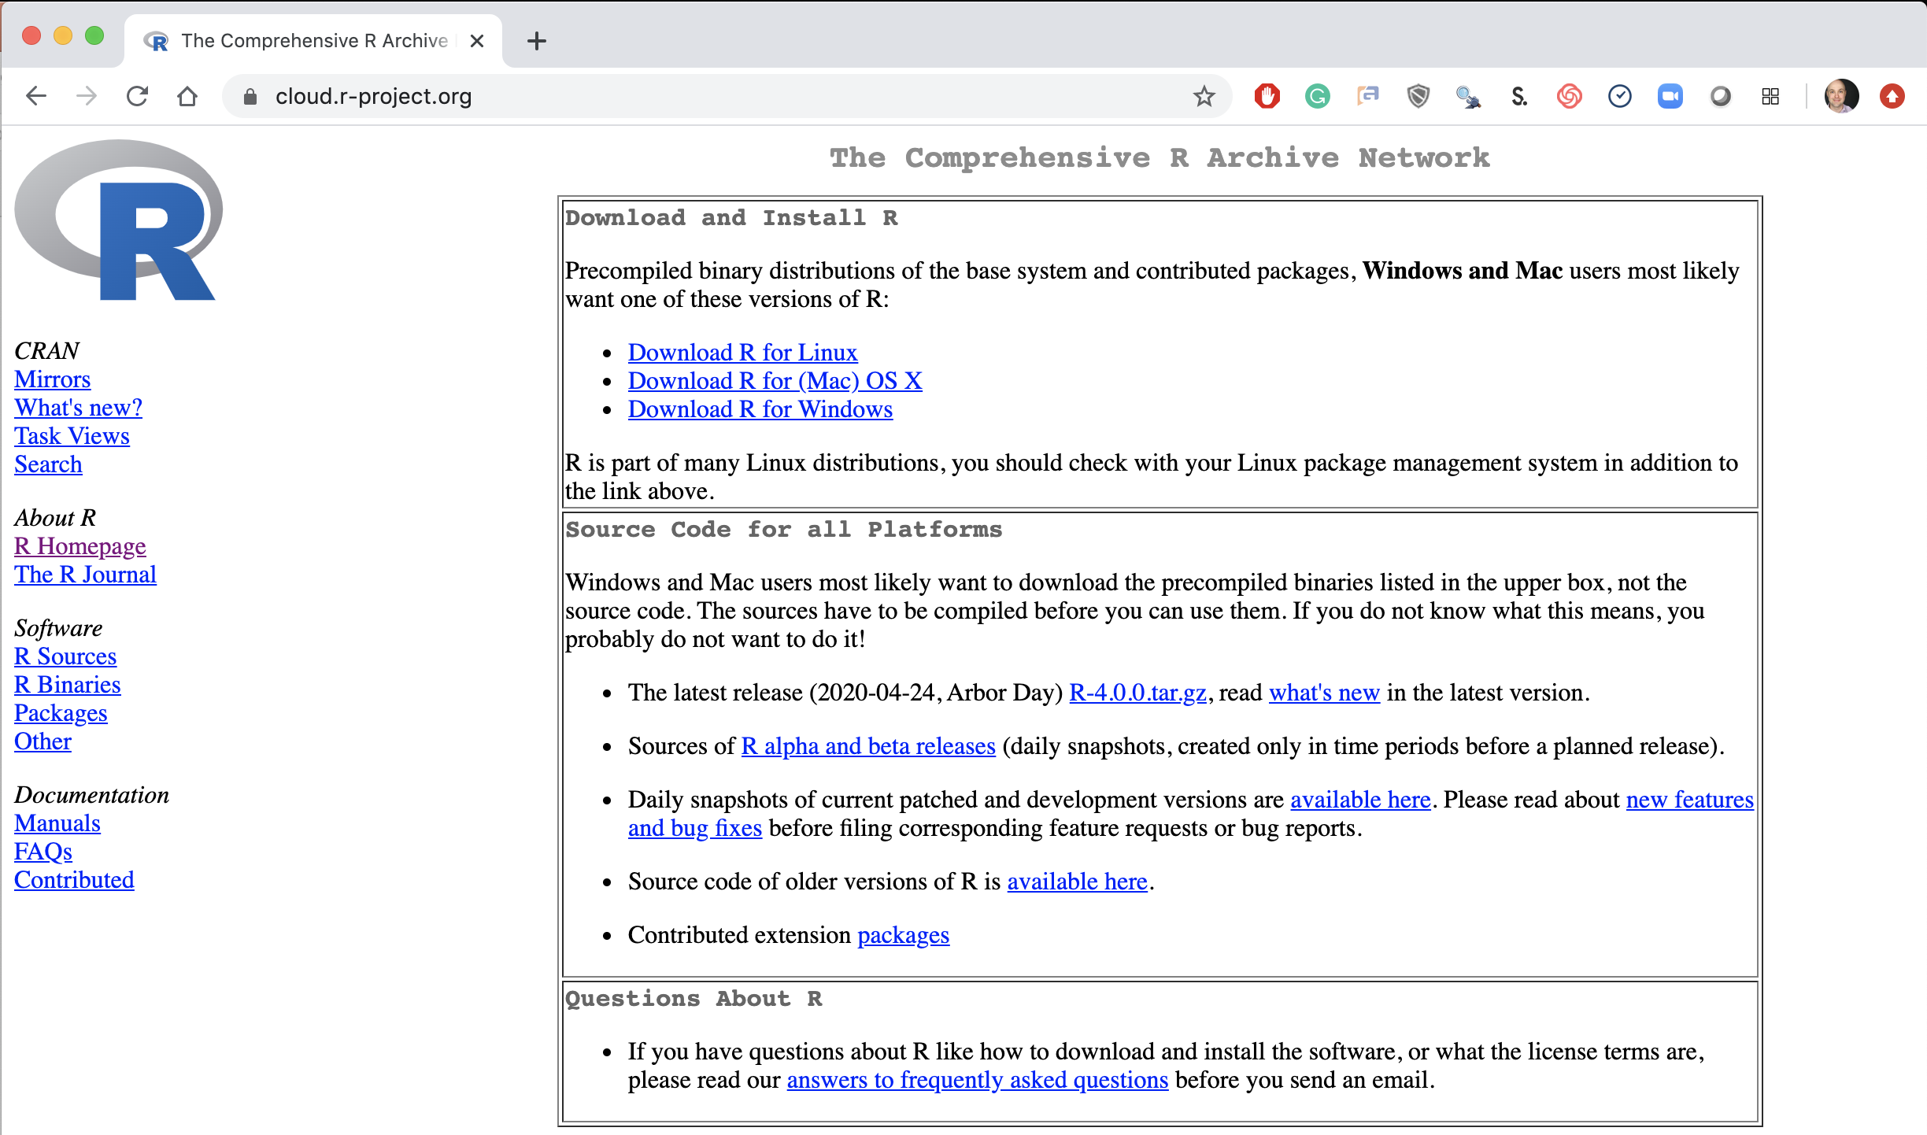
Step 1. Install Base -R
Local Laptop – Windows or Mac
Download the appropriate version Linux, Mac or Windows.
https://cloud.r-project.org/

Slide 11
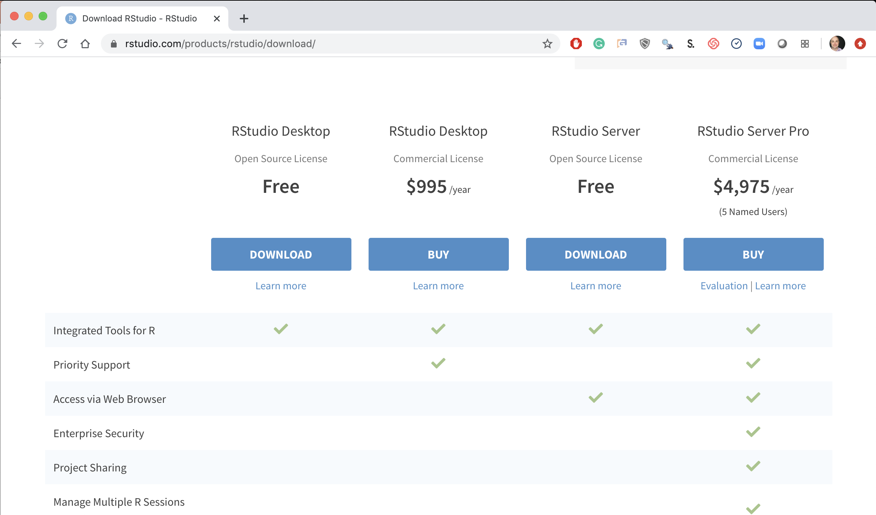
Step 2. Install R-Studio
Local Laptop Windows or Mac
Download the R Studio Desktop (Free).
https://rstudio.com/products/rstudio/download/ &
https://rstudio.com/products/rstudio/download/#download

Slide 12
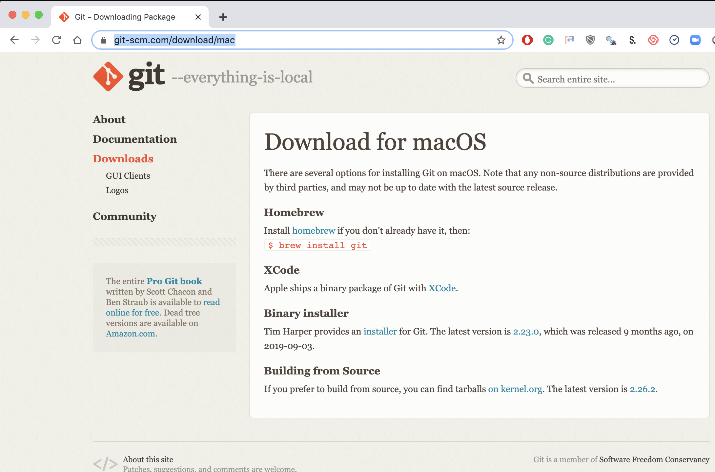
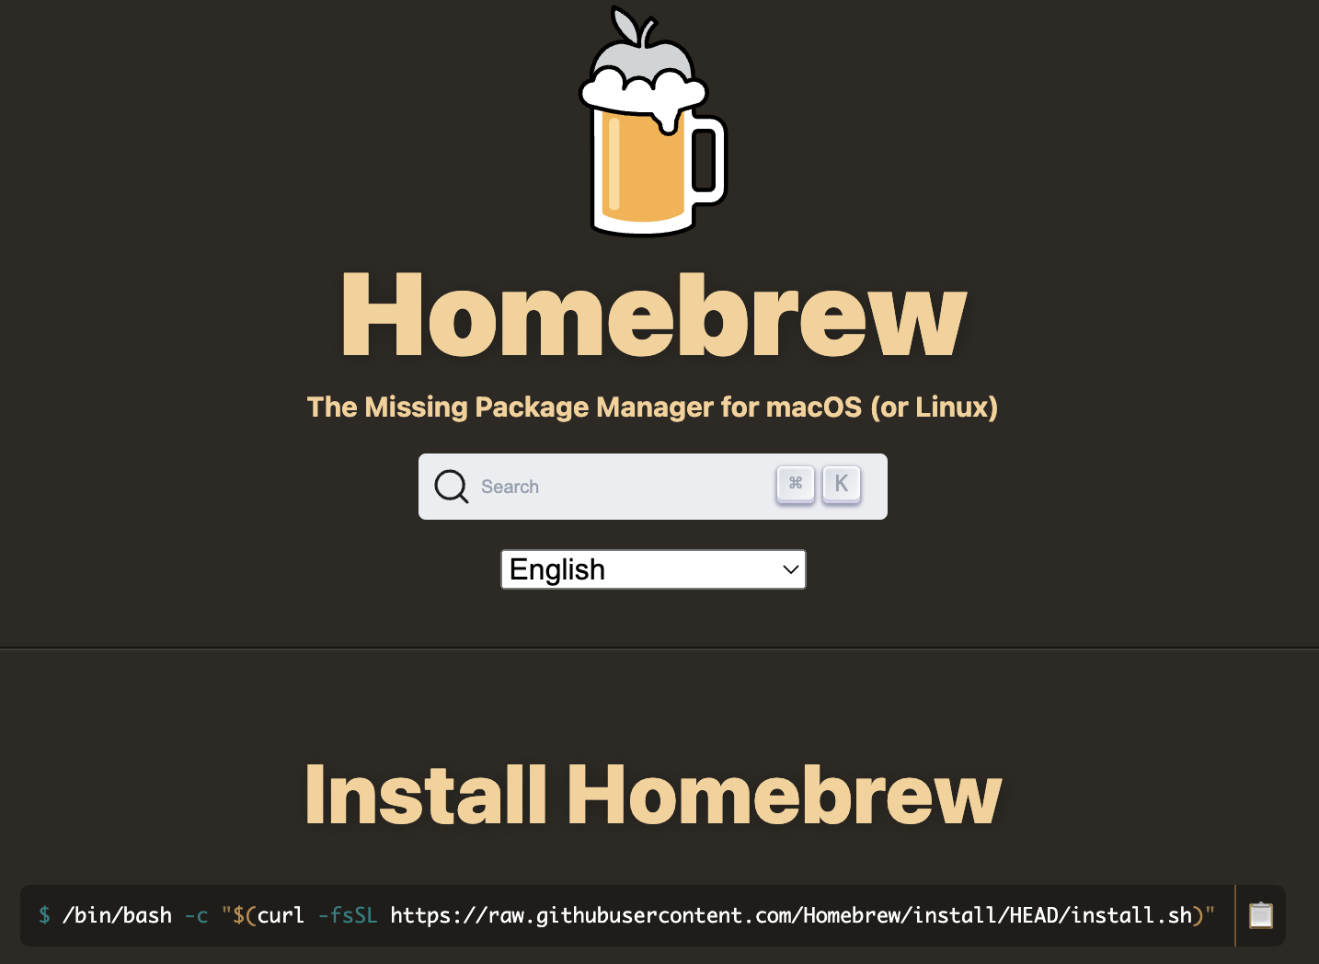
Step 3. Install Git (Mac)
Local Laptop Apple – INSTALL BREW FIRST
Download the Git Program, then follow prompts for installation.
www.brew.sh
https://git-scm.com/download/mac
https://www.youtube.com/watch?v=twFo9wCpdSU

Slide 13
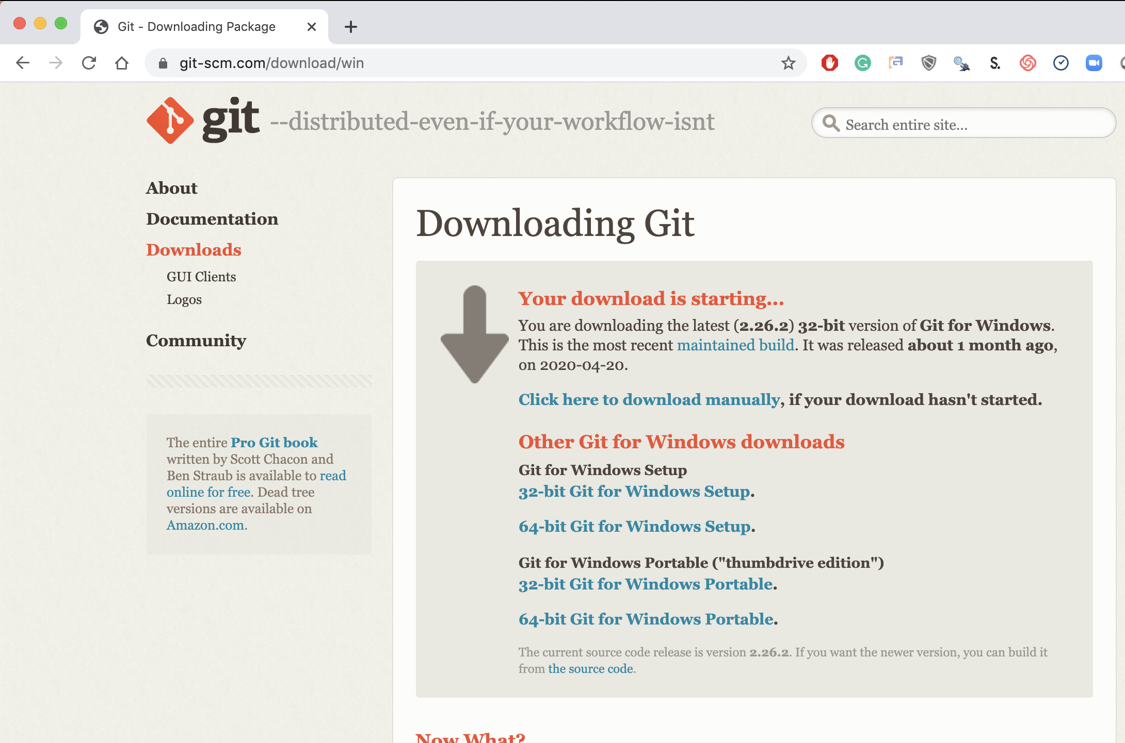
Step 3. Install Git (Windows)
Local Laptop MSFT
Download the Git Program, then follow prompts for installation.
https://git-scm.com/download/win &
https://www.youtube.com/watch?v=nbFwejIsHlY

Slide 14
Now that you have R, R-Studio & Git, time to connect to our class repository.
Connect to git repository.
R Studio sits on top of base R & adds functionality.
Class Files hosted on github.com
Makes the programmatic connection.

Slide 15
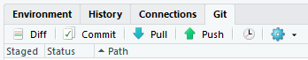
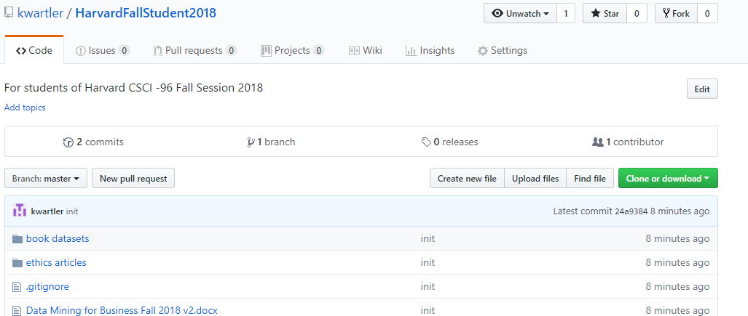
To get scripts, pptxs & data use the class repo
https://github.com/Kwartler/[insert_repo_name]
If you have git software, when do a “git pull” in Rstudio.
Alternatively you can download a zip of the repo on github.com but this can be cumbersome with file updates.

Slide 16
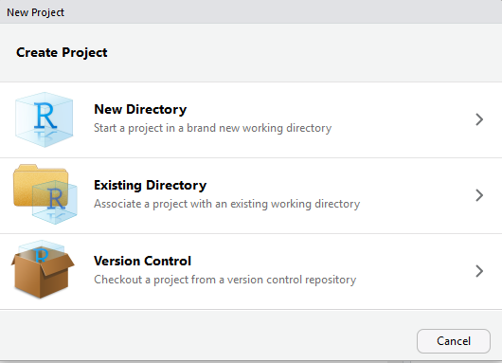
Now let’s get class files by setting up a new project & do a “git clone”
https://github.com/kwartler
Open R Studio
File
New Project
Version Control

Slide 17
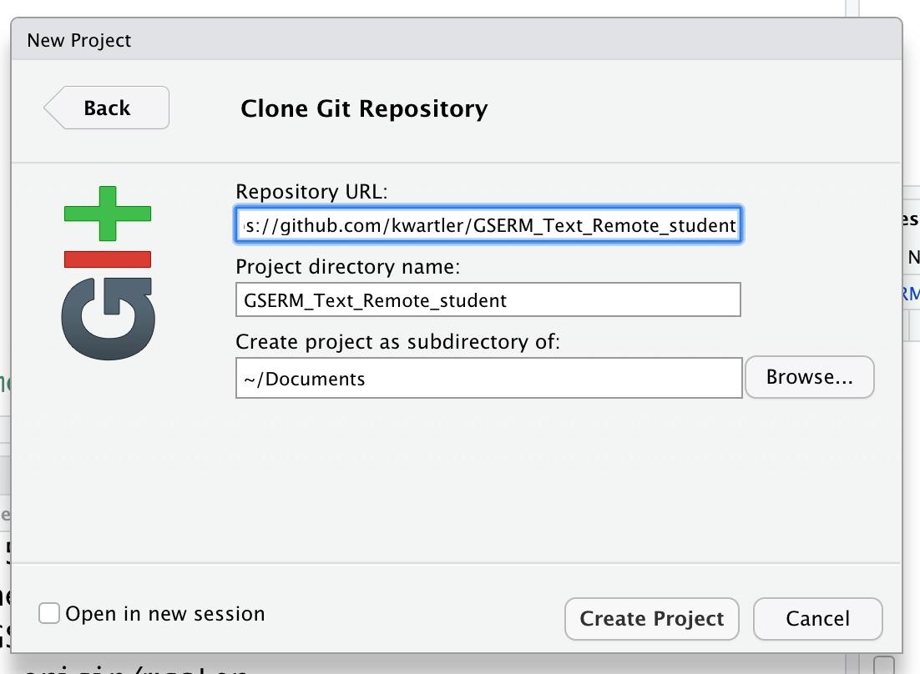
Setup a new project & do a “git pull”
In R Studio
File
New Project…
Version Control
Select Git
Add URL, folder name & destination for files

Slide 18
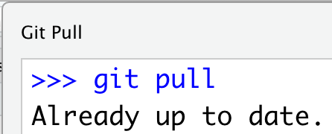
As you get more experience using git will help you.
In R Studio
File
New Project…
Version Control
Select Git
Add URL, folder name & destination for files
EACH Class session perform a Git Pull to update files

Slide 19
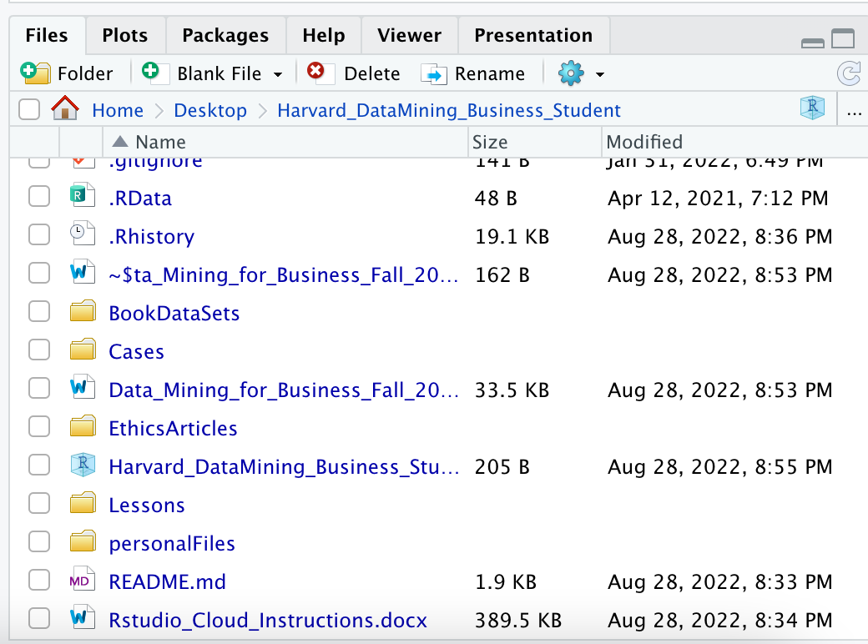
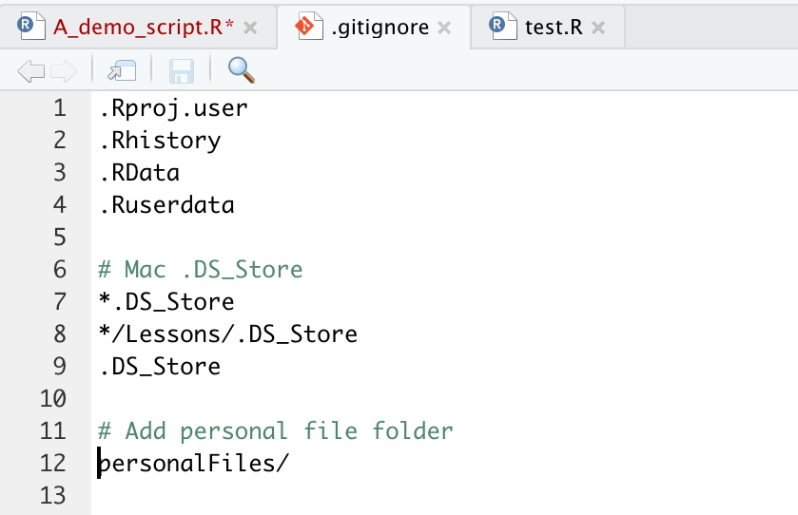
Saving YOUR copy of files.
To avoid conflicts with the class files create a “personal” folder that is ignored.
1 Create the Personal Folder
2 Add to the “gitignore” file
SAVE All your work there, copies of class files, homework, cases.

Slide 20
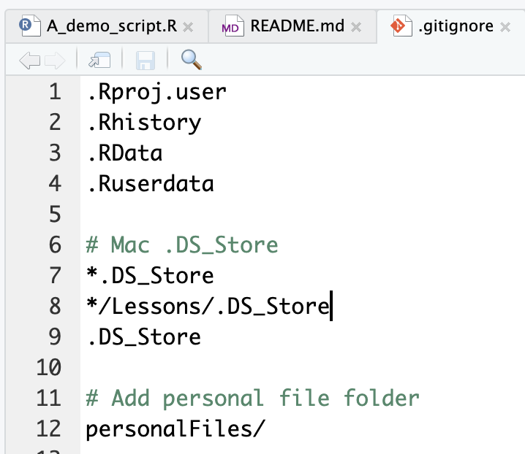
Second to last item. Create a personal folder.
Open the “gitignore” file. Add slash personal
Name of folder to be ignored “personalFiles”
When you work and make changes to scripts, SAVE AS to a personal folder that is ignored by git.

Slide 21
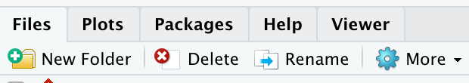
Second to last item. Create a personal folder.
In the lower right file section click “New Folder”. Name it “personal” exactly as in the gitignore (capitalization)
Click New Folder

Slide 22
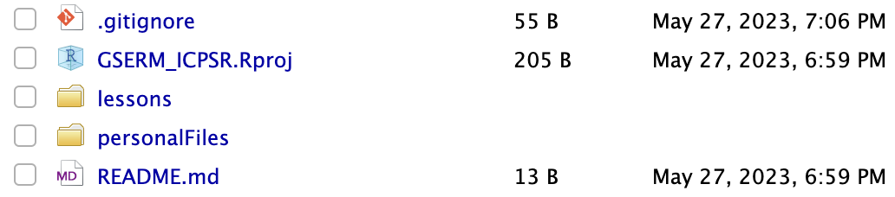
Save yourself a headache! Create a personal folder.
In the lower right file section click “New Folder”. Name it “personal” exactly as in the gitignore (capitalization)
Any file you change should be in this folder as “Save As”

Slide 23
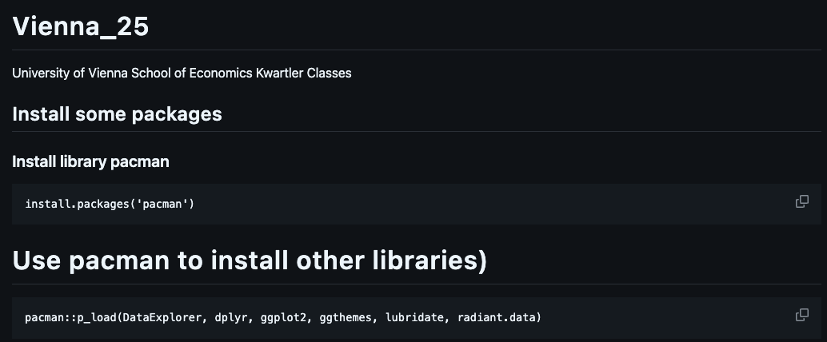
Now just run some code (we will explain it later)
https://github.com/kwartler/[select _the_repo] has the R code.
If you have R, Rstudio, Git, then made a connection and can run this code…you’re off to a great start! And don’t worry if you hit a hiccup, we will figure it out.

Slide 24
Almost setup…don’t worry if you need help!

Slide 25
Intro to R
Why? This ensures a basic fluency before the course really starts.
Learning Objectives
What is R?
What is R Studio?
Scripting Structure in this course

Slide 26

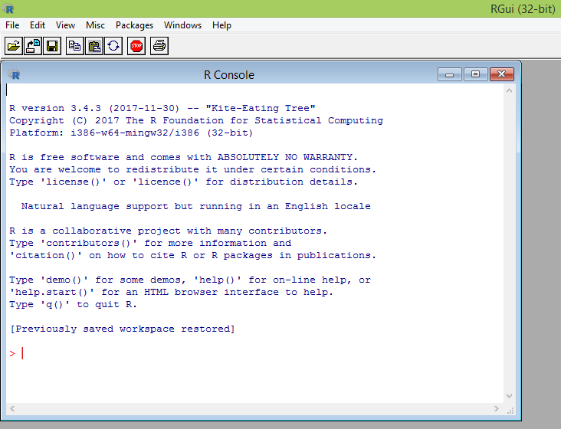
What is R?
R is a language & environment for statistical computing and graphics. It is the most popular statistical software in circulation today and is used by more than 2 million data scientists & statisticians worldwide.
How Companies Use R to Compete in a Data-Driven World, Data-informed.com
Flexible
Open source
Academic & growing in industry
Language agnostic, SQL, Weka, C, Fortran, Java etc

Slide 27

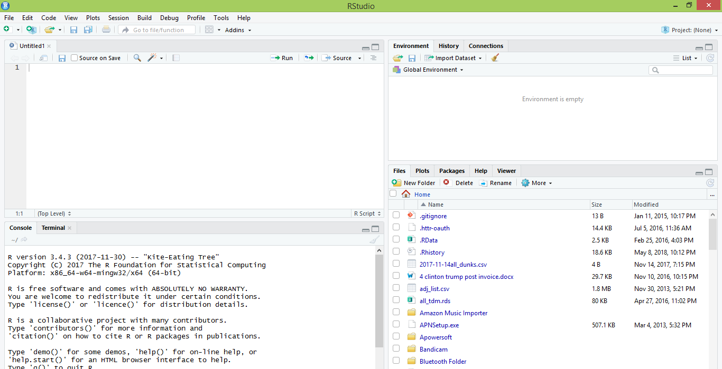
What is R Studio? The most popular IDE for R
IDE – Integrated Development Environment
Adds additional functionality e.g. git, shiny projects, markdown templates

Slide 28
What is the relationship between R & R studio?
Nice interface & additional functionality for faster programming, analysis & production.
Statistical & graphing software
R Studio sits atop of the installed R version. Without base R, R studio cannot function. By programmatically accessing base R, R Studio improves the interface and functionality.

Slide 29
R Studio has four main panes
Scripting
Environment
Commands are written & adjusted here then executed in the console. Then saved for future quick execution.
List of objects & values
e.g. loaded “excel” files
Files, Plots, Packages, Help
Console
Find files, load packages, see visualizations and quickly find help
Execution of scripts and commands, data exploration and code results
R Studio works on Linux, Windows and iOS.

Slide 30
R: Where is it being used?
Media
Google
Facebook
Twitter
Foursquare
Kickstarter
New York Times
Economist
Services
Zillow
Trulia
eHarmony
DataSong
PredictWise
Nationwide
Finance
Lloyd’s Bank
Credit Suisse
American Century
Australia and New Zealand Banking Group
Technology
SAS
Oracle
IBM
Teradata
Coursera
SAP
DataCamp
Alteryx
TIBCO
OneTick
Amazon
Google
Microsoft
U.S Government
Food & Drug
Administration
National Weather
Service
National Institute
of Standards
in Technology
R is ubiquitous in various industries used for analysis, prototyping and visualization. However, more often python is used in production environments.

Slide 31

Ok, it’s awesome
Pros
VERY extensible
10K+ packages
Built by stats, made for stats
Free, open source
Cutting edge
Diverse applications
Outstanding graphical capabilities
Large community-based help
AI Generated

Slide 32

Ok, it’s awesome but…
Cons
Tough to do “big data”
In memory data constraints w/o extra effort
Official documentation is terse
Not as polished as a commercial application
Slow compared to lower level languages
Production worthy apps can be difficult to create
Large community-based help
AI Generated

Slide 33
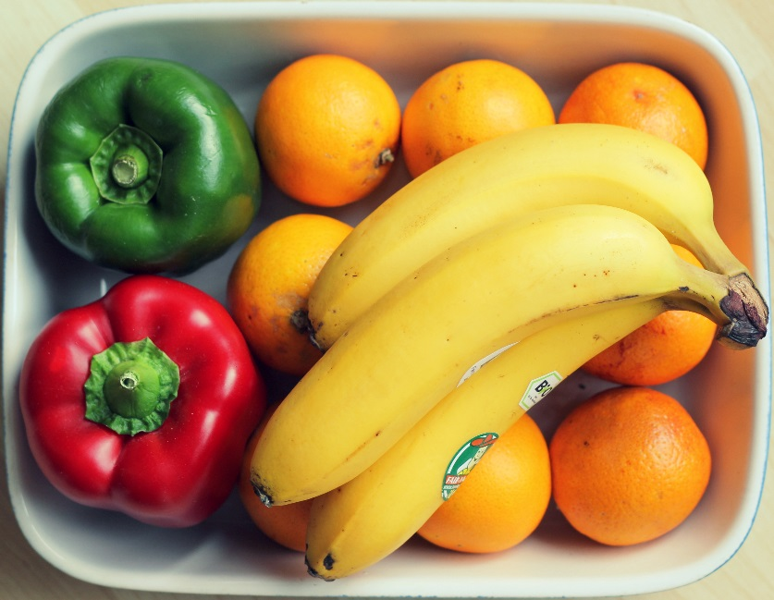
A basic R workflow
Let’s eat a banana for breakfast. Where is the fruit?
If a “local” file define the path to the file
OR WINDOWS
scenesDF <- "C:\\Documents\\hult\\ forceAwakens_definedScenes.csv"
OR MAC
scenesDF <- "~/Desktop/Hult/forceAwakens_definedScenes.csv"
OR
From a URL
scenesDF <- 'https://raw.githubusercontent.com/kwartler/Hult_Visualizing_Analyzing_Data_with_R/main/Lessons/A_Intro_Admin/data/forceAwakens_definedScenes.csv'
The item of interest needs to be in the “working directory” or a defined path

Slide 34


R uses functions, libraries & objects
Found the fruit basket! What tools do I need?
# Load Libraries
library(knife)
library(peel)
Change R into a breakfast preparing machine with specialized libraries.

Slide 35

Another trap!
Before loading a library use
install.packages(“name of package”).
You only need to do this once per environment
But you will need to repeat it w/each new environment!

Slide 36

R uses functions, libraries & objects
Now R is a cutting & peeling machine, let’s pick our fruit.
library(knife)
library(peel)
banana <- read.csv(“Banana.csv”)
OR
banana <- read.csv(www.csvFile.csv)
Must
Be In the working directory or full path declared
Be inside quotes
Have correct capitalization, spacing & spelling matter.
Must
Refer to the URL
Or be the URL in quotes
R now has the object called banana in memory ie “opening a spreadsheet”

Slide 37

What if my file is Excel or ???
R can open many files types with different functions
CSV
Excel
SaS
SPSS
Rds, rda, fst etc
Connections
Databases (SQL, mongoDB)
S3 Buckets
APIs
Recommendation: to get started stick with CSV. Most software can export CSV. Most class files are CSV.

Slide 38
R uses functions, libraries & objects
Function
Input
Output
R uses predefined functions to accomplish things.

Slide 39
R uses functions, libraries & objects
Our Function accepts any number and is a “plus 2 and multiply by 3” Machine.

Slide 40
R uses functions, libraries & objects
plusTwoTimesThree
Input
X = 2

Slide 41
R uses functions, libraries & objects
plusTwoTimesThree
X = 2
2+X = 4
4 * 3 = 12
Return (12)
Input
X = 2

Slide 42
R uses functions, libraries & objects
plusTwoTimesThree
X = 2
2+X = 4
4 * 3 = 12
Return (12)
Input
X = 2
Output
12

Slide 43
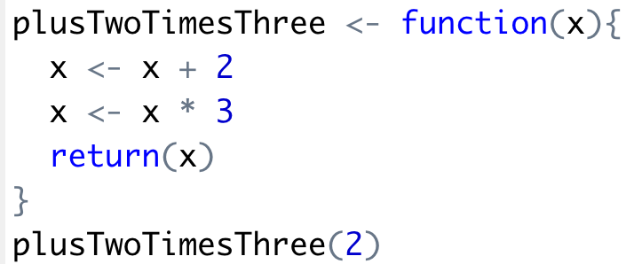
R uses functions, libraries & objects
Input
X = 2
Output
12

Slide 44
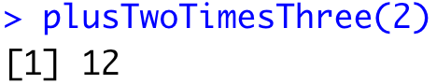
R uses functions, libraries & objects
Input
X = 2

Slide 45
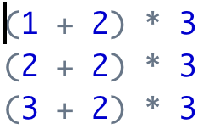
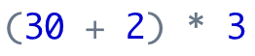
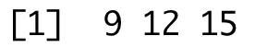
Why are functions better?
Write it 30 times
Write it once
etc.
Apply it in one line
Get all the answers
Get all the answers
etc.
etc.
Saves time, more concise and less error prone.

Slide 46

R uses functions, libraries & objects
halfBanana <- cutinhalf(banana )
Output
Function
(
Input
)
“ <- ” is the assignment operator

Slide 47


R uses functions, libraries & objects
library(knife)
library(peel)
banana <- read.csv(“Banana.csv”)
halfBanana <- cutinhalf(banana )
halfBanana <- peel ( halfBanana)
Output
Function
(
Input
)
Results of an object can be used in the next function.

Slide 48
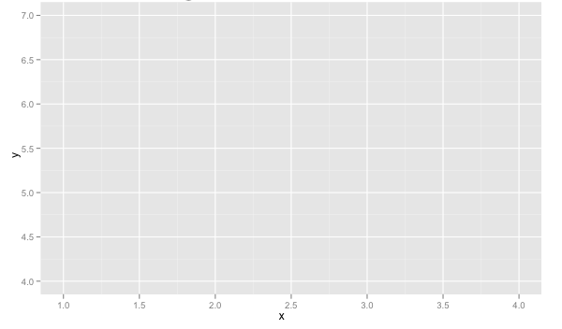
R uses functions, libraries & objects
setwd(“ted/fruit/basket”)
library(knife)
banana <- read.csv(“Banana.csv”)
halfBanana <- cutinhalf(banana)
halfBanana <- peel(halfBanana)
plot(halfBanana)
Function
(
Input
)
You don’t always have to declare an output object & you can also save items to disk.

Slide 49






Workflow review
1
Use file paths to point to your files & where to save outputs.
2
Load some customized libraries with library() for your specific analysis and methodology. Sometimes we will also create customized functions not in a library to aid our analysis.
3
Read in the file so the object is “in-memory” with read.csv() or similar.
4
Apply a function(s) from a library to adjust or create new objects in memory. The pseudo code for this is:
object<-function(applied to object)
5
Consume the results by saving, plotting etc.

Slide 50
On to more interesting stuff!

Slide 51
Let’s get into some code!
Open up
﻿A_Basic_Test_Drive.R

Slide 52
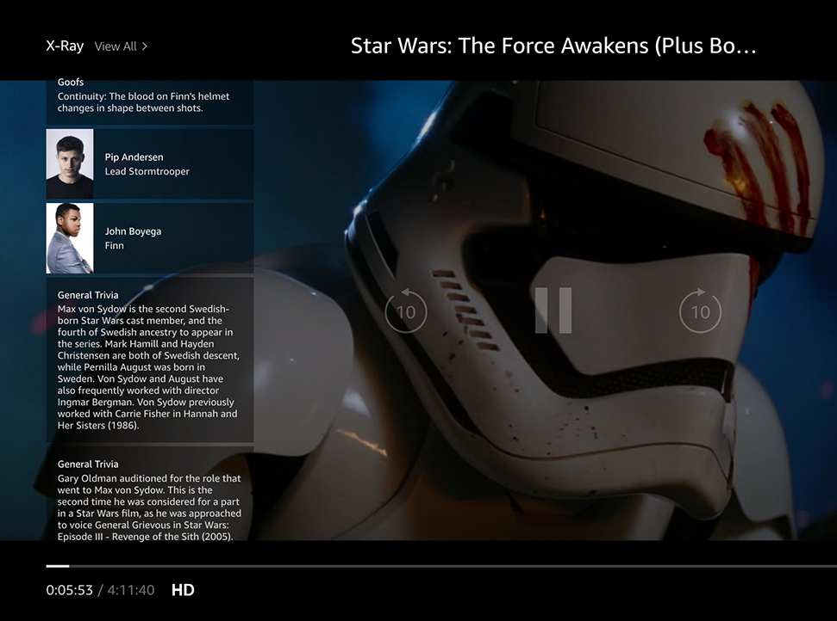
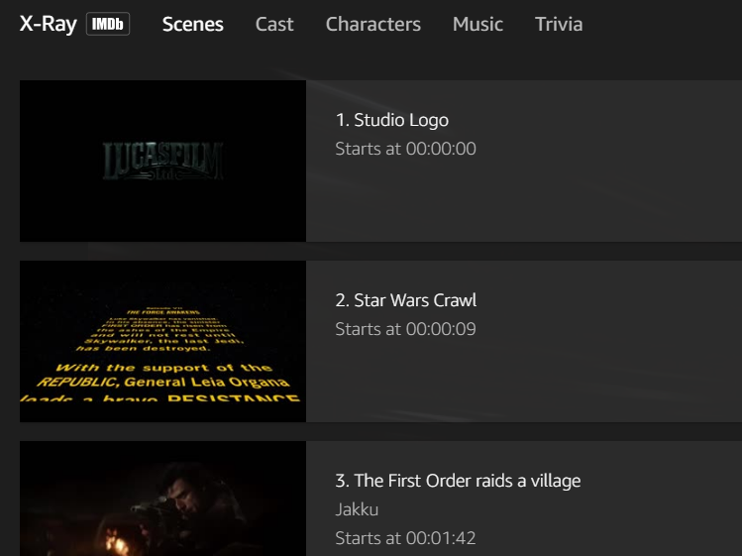
Amazon X-Ray: Movie Meta Data
Left Hand Screen:
Actor Information & Trivia
Center “Pop-over” Screen:
Scenes, Cast, Characters, Music & Trivia

Slide 53

Let’s practice! Open B_Amazon_Xray.R
Learning Outcome: Following a consistent workflow, load, clean, & analyze real data with multiple data types to establish basic familiarity.
Your choice!

Slide 54

ggplot2 is the grammar of graphics
ggplot(plotDF, aes(colour = name))
Layers are declared and added in sequence to construct a visual.

Slide 55
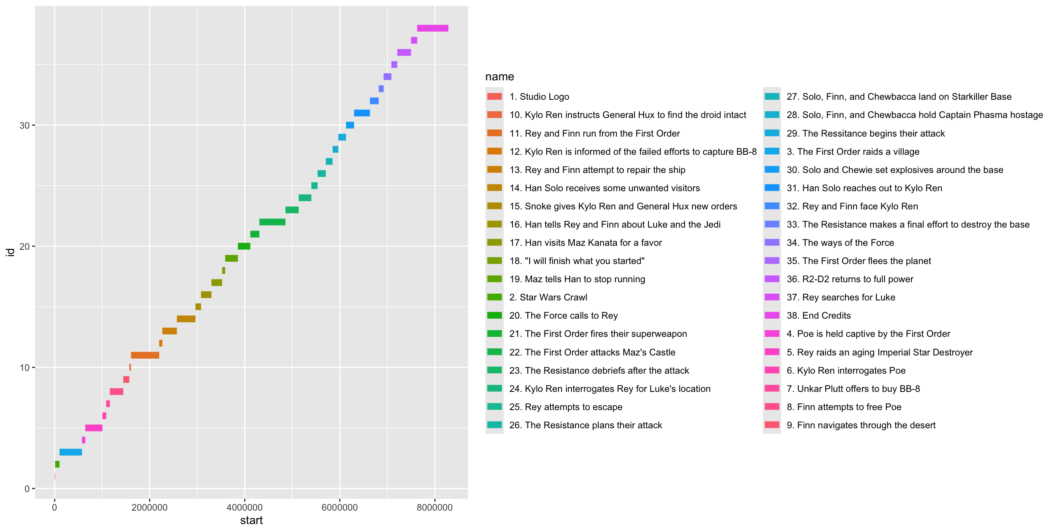
ggplot2: adding a layer
ggplot(plotDF, aes(colour = name)) +
geom_segment(aes(x = start, xend = end,
y = id, yend = id), linewidth = 3

Slide 56
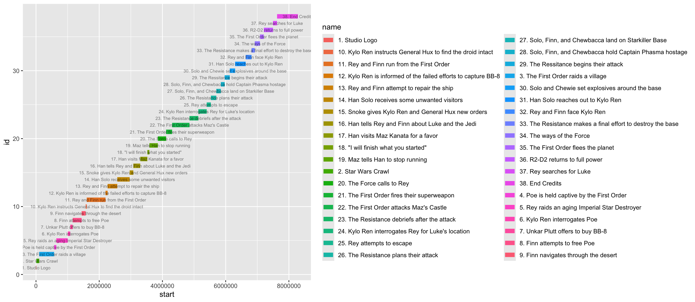
ggplot2: adding a layer of text
ggplot(plotDF, aes(colour = name)) +
geom_segment(aes(x = start, xend = end,
y = id, yend = id), linewidth = 3) +
geom_text(data=plotDF, aes(x = end, y = id, label = name),
size = 2.25, color = 'black', alpha = 0.5, check_overlap = TRUE) +

Slide 57
gpplot2: Adding an aesthetics layer
ggplot(plotDF, aes(colour = name)) +
geom_segment(aes(x = start, xend = end,
y = id, yend = id), linewidth = 3) +
geom_text(data=plotDF, aes(x = end, y = id, label = name),
size = 2.25, color = 'black', alpha = 0.5, check_overlap = TRUE) +
theme_gdocs() + theme(legend.position = "none") +
ggtitle(movieTitle)

Slide 58
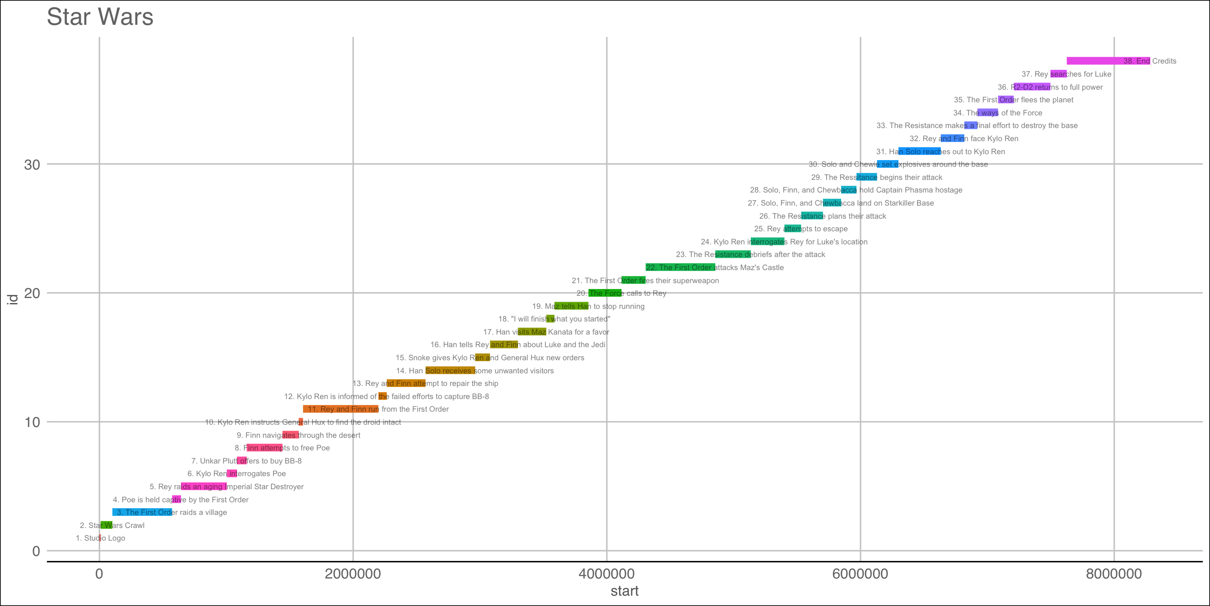

Slide 59
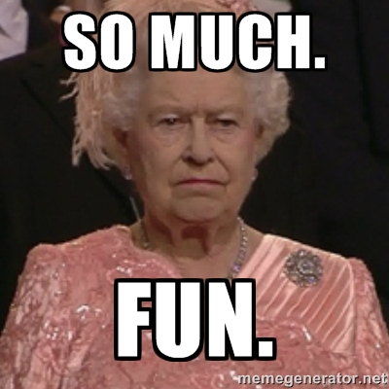

Slide 60
Appendix

Slide 61


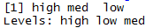
As you just saw R has many data types.
Numeric/Integer
Factors (Distinct Classes)
as.factor(c('MALE','FEMALE','FEMALE'))
1
10
12
3.47
82
MALE
FEMALE
FEMALE
Unordered
Cardinality
2
c(1,10,12,3.47)
[1] MALE FEMALE FEMALE
Levels: FEMALE MALE
High
Med
Low
Ordinal
as.factor(c(‘High',‘Med',‘Low'))
Cardinality
3
Boolean
STRING (just text)
c('MALE','FEMALE','FEMALE')
TRUE
TRUE
FALSE
TRUE
FALSE
c(T, T, F, T, F)
c(TRUE,TRUE, FALSE, TRUE,FALSE)
c(T,TRUE, F, TRUE,FALSE)
[1] "MALE" "FEMALE" "FEMALE"
In R, a vector can be numeric, Boolean (T/F), factors, or contain strings.

Slide 62
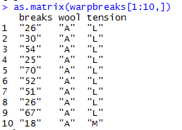
More Complex Common R Object Types - Matrix
Matrices are 2 dimensional data (rows/columns). Each column must be the same type.
RowID | breaks | wool | tension
1 | 26 | A | L
2 | 30 | A | L
3 | 54 | A | L
4 | 25 | A | L
5 | 70 | A | L
6 | 52 | A | L
7 | 51 | A | L
8 | 26 | A | L
9 | 67 | A | L
10 | 18 | A | M
All strings
Matrices are organized into rows & columns. Row names are not actually a vector of the matrix but are an attribute of the matrix. In excel you would need a standalone vector to capture that information.

Slide 63
More Complex Common R Object Types – List
Lists are multi-dimensional objects that can contain different data types of different lengths.
ListA
single value
Single data frame or matrix
single vector
Nested list
Nested data frame
Nested matrix
Lists are useful for data organization but can be complex and difficult to navigate to get specific information.

Slide 64
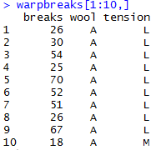
More Complex Common R Object Types – Data Frame
Data Frames are like 2 dimensional data objects but can have mixed data types.
A data frame is actually a named list but with equal length elements. Being a list lets it contain mixed data types.
RowID | breaks | wool | tension
1 | 26 | A | L
2 | 30 | A | L
3 | 54 | A | L
4 | 25 | A | L
5 | 70 | A | L
6 | 52 | A | L
7 | 51 | A | L
8 | 26 | A | L
9 | 67 | A | L
10 | 18 | A | M
Integers
Factor
Factor
Unlike a matrix, DFs can hold different types of vectors

Slide 65
When should you use a specific data type?
Number of Dimensions >1
No
Yes
Use a Vector
Data Types >1
No
Yes
Matrix or Array
Data Frame or List
Most analyses start with a data frame, and change classes as needed.

